Slide 1
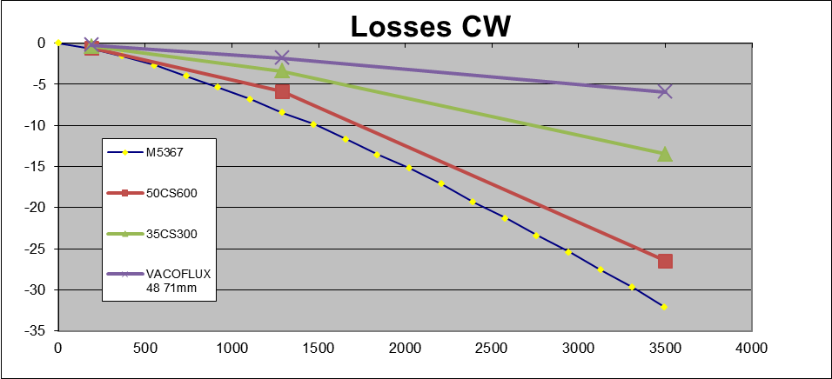
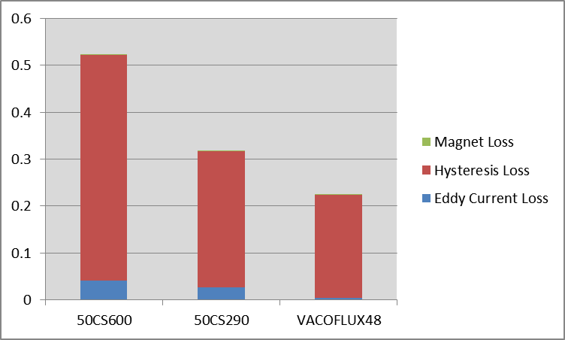
Reduction of Motor Friction
Point of
Interest
Finite Element
Models
Measurements
Data Collected from Samples
Simulation Results for 9s6p (K2XX)
26 mNm
Core Loss (Watts) / Friction at 190 RPM
16 mNm
11 mNm
Reduced by 43%~46%
Reduced by ~40%

Slide 2
Reduction of Motor Friction-contd.
Motor Friction is about 40% of the total System Friction
Reduction in friction w/ low core loss material
50cs290 has about 52% lower loss than 50cs600
Motors with 50cs290 showed about 40~45% reduced friction at low speed
No need for reducing lamination thickness
Cost of lamination steel (Si- steel) is a function of core loss
Minimum changes in tooling life and material cost
53mm motor (27/6 shed) incur an increase in cost of $1.40
Motor piece price impact will need to be quoted on program to program basis as there could be some other associated costs (heat treat difference, error proofing, gross/net weight)
Other exotic material (Co-steel, Ni-steel etc.)
Very expensive material ??
Motor needs to be resized
Lighter and Smaller Machine (~0.5Kg less and Stator OD~76mm) possible
Tooling life and other processing might change

Slide 3
Reduction of Motor Friction-contd.
Motivation score – 6
On Track – Motor level study completed
Status - Green

Slide 4
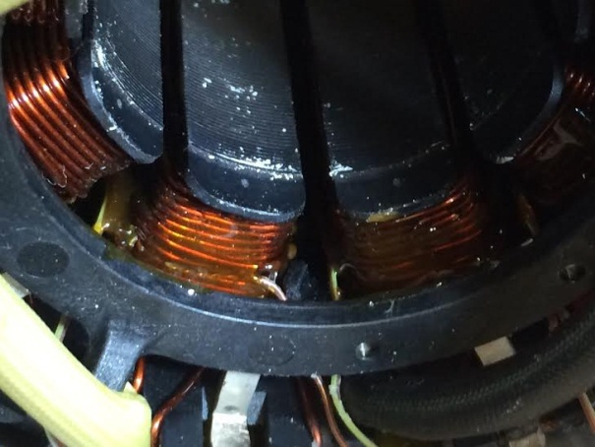
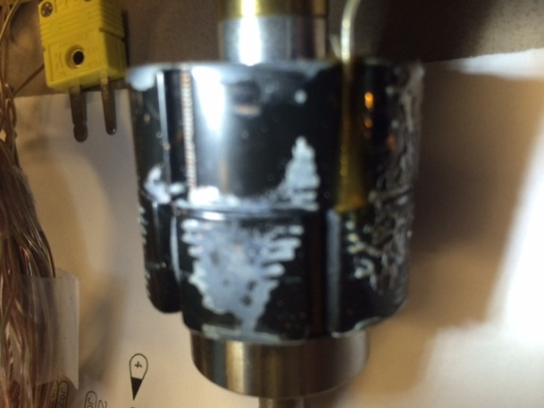
Measures to Reduce Motor Thermal --PP 126
Thermal reducing options tested on PSA BMPV motor
Varnished stator
New plastic insulator (copper filled)
Varnished stator with new insulator
Additional Thermal reducing options
Potting the bottom end turn to motor housing
Thermal couple on top of winding at each phase and rotor

Slide 5
Measures to Reduce Motor Thermal - contd.
Thermal Characterization of Motors (accuracy low to high)
Lumped parameter analytical model
Future direction
Combined electromagnetic and thermal analysis-CAE tool
CFD based FEA
Tests on PSA motor

Slide 6
Measures to Reduce Motor Thermal - contd.
Motivation score--6
On track
Status - Green

Slide 7
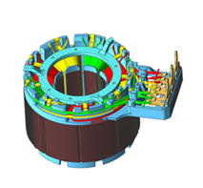
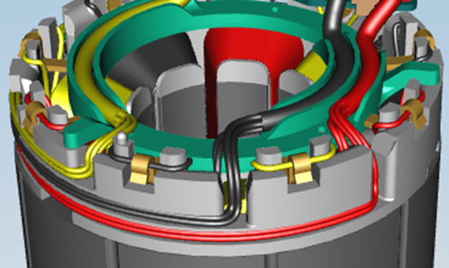
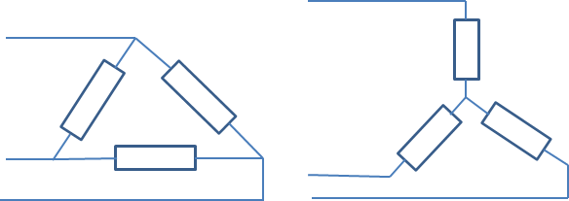
PP- 153: Delta vs. Wye Motor
Description
Implementation of Delta vs. Wye Connection Motor
Replacing Wye with Delta and eliminate neutral bus-bar
Motivation (4)
Simplification of Motor Winding for Suppliers and elimination of connections (6 or 9 depending on Implementation)
Cost Savings
Deliverables
Validated Design that is interchangeable to the existing motor
In vehicle evaluation
Review Impact on Dual Windings (VSS - LoA Impact)
Timing
2016 BMW
Team Members/Customers
Rakib Islam
Joanne Tersigni
Eliminate this neutral bus-bar
Delta Wye
3-phase winding layout: delta vs wye

Slide 8
PP- 153: Delta vs. Wye Motor- contd.
Motivation score--4
Supplier did not show the cost savings yet
Status – Red
More study in progress to come up with terminal design with no bus-bar

Slide 9
Cogging Torque: A Competitive Analysis
Key to the project PP 123 , PP 124:
Optimized High Output Motor Design
Cost Optimized Motor Design (IPM/skew/pole shape/WIH)
Need to understand the competition and our strengths
Motivation score – 5, 10 respectively
Need Software Optimized to Provide Cancellation with Low Voltage budget
Before we can proceed with any new motor optimization.
Tried optimizing with R1=R2 and
Was not successful due to high Voltage Budget to provide Cancellation.

Slide 10
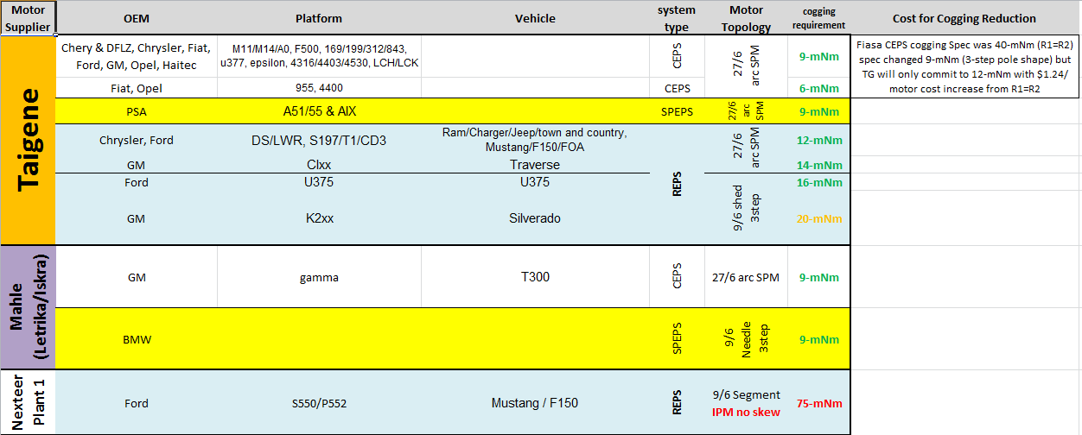
Cogging Torque: A Competitive Analysis - contd.
Existing Nexteer BLDC Motor Suppliers and current cogging requirements.

Slide 11
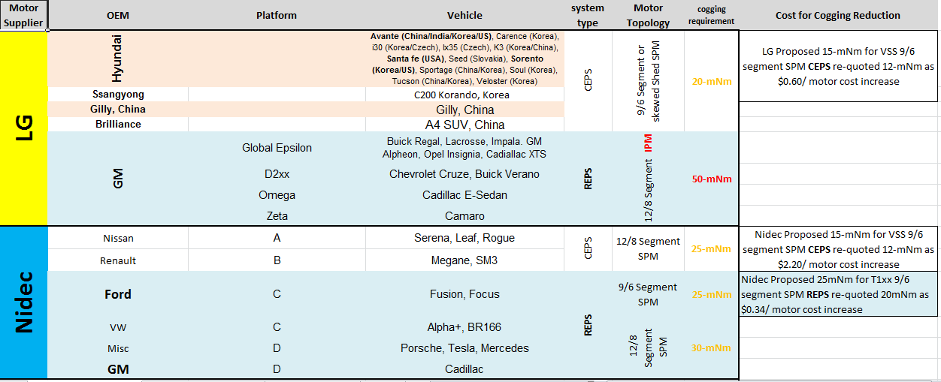
Cogging Torque: A Competitive Analysis - contd.
New Nexteer BLDC Motor Suppliers and cogging requirements.

Slide 12
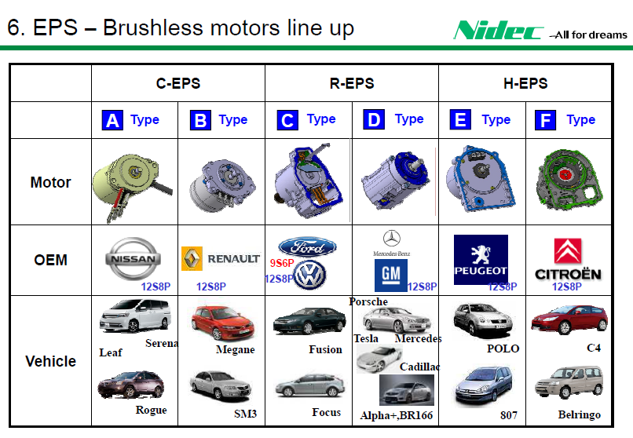
Cogging Torque: A Competitive Analysis - contd.

